Slide 1
COFFEE SHOP SALES
INTRODUCTION
Problems TO ANSWER
Process
Insights
Summary

Slide 2
INTRODUCTION
This transaction record pertains to Maven Roasters, a coffee shop with three establishments in New York City. The objective of this analysis is to scrutinize the coffee shop data and acquire insights regarding the location with the highest customer count, most substantial revenue, top-performing product, and highest sales volume. The analysis encompasses data cleansing, visualization, filtering, and computations to yield a comprehensive understanding. Its purpose is to provide recommendations and facilitate well-informed business decisions.

Slide 3
PROBLEMS TO ANSWER
Which coffee chop sales trended over time?
Which days of the week tend to be busiest
Which product are sold most and least often?
Which drive the most revenue for the business?
Which store location has the most customers

Slide 4
PROCESS
Data gathering.
Data cleaning
Data modelling
Data analysis
Uncovering insights

Slide 5
Data Over View
This dataset presents information from a fictional coffee shop in New York City. The data is used to gain insight and support business analysis of sales patterns, customer preferences, sales volume over time, and business performance.
KPIs
Product : 9
Total Revenue: 699k
Total order : 149k
Total stores: 3
Total Item sold: 214k
Total product type: 29

Slide 6
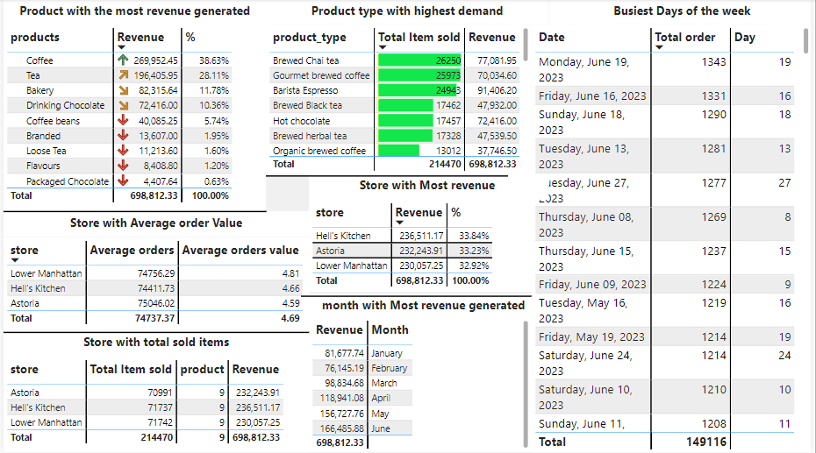
Over View

Slide 7
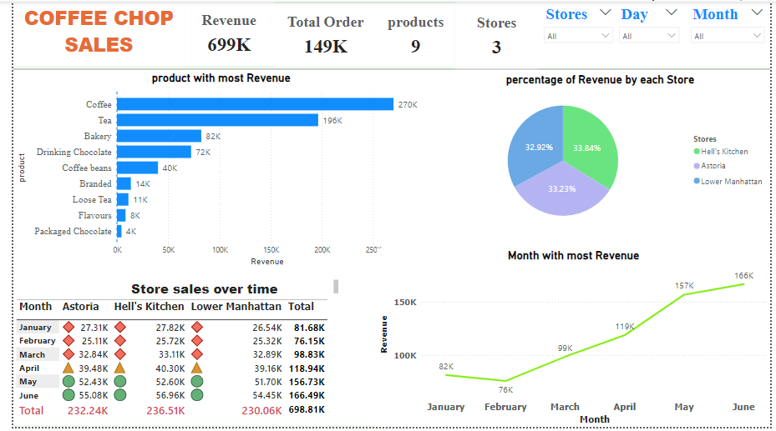
Revenue Dashboard

Slide 8
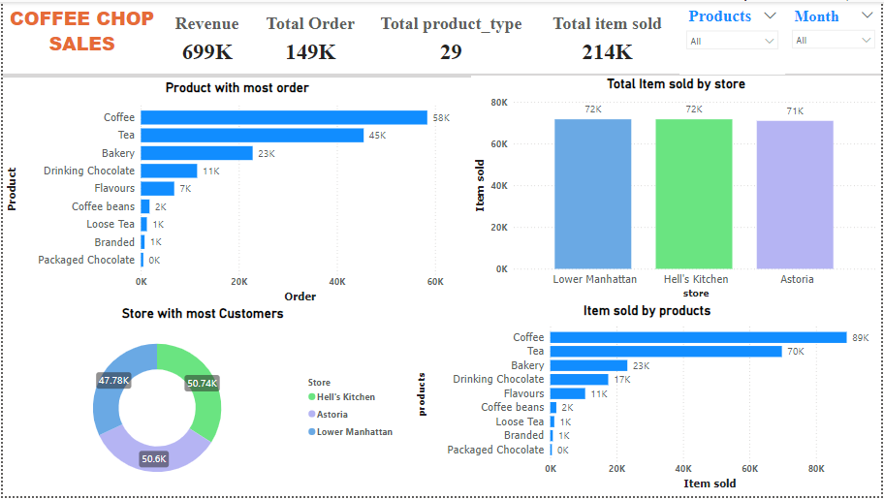
Product Dashboard

Slide 9
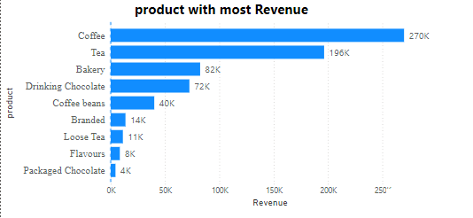
PROBLEMS ANSWERED
Which drive the most revenue for the business?
1. Coffee has generated the highest revenue over time, totaling $269,952k
.2. Tea follows with a revenue of $196,406k.
3. Bakery is the third highest revenue generator with a total of $82,316k.
4. Drinking Chocolate comes in fourth with a total revenue of $72,416k.
These are the top four revenue generators over time.

Slide 10
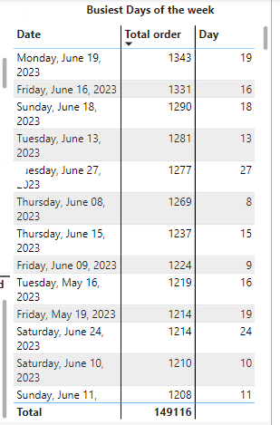
Which days of the week tend to be busiest
Monday, June 19th had the highest number of orders with 1,343, followed by Friday, June 16th with 1,331 orders, and Tuesday, June 13th with 1,281 orders.

Slide 11
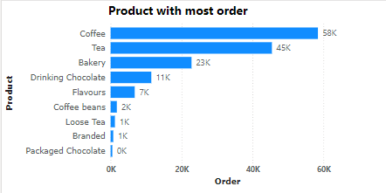
Which product are sold most and least often?
The coffee shop sells a variety of products. The best-selling product is coffee, with a total of 58,416 orders, while the least sold product is Packaged Chocolate, with a total of 487 orders.

Slide 12
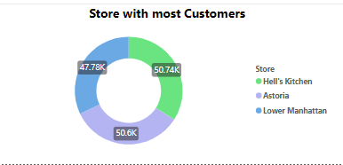
Which store location has the most customers
The coffee shop operates across three locations in New York City. Our analysis indicates that Hell’s Kitchen attracts the highest number of customers, with 50735 individuals choosing this store for their coffee needs.

Slide 13
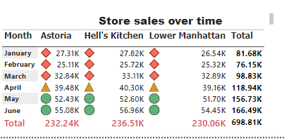
Which coffee shop sales trended over time?
Hell’s Kitchen is the top-performing coffee shop, having generated an impressive $236.51K in sales. From January to June, it has consistently outperformed other stores in maintaining the highest sales trend.

Slide 14
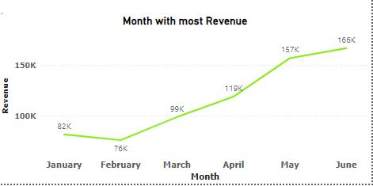
Month with most Revenue
The data from the coffee shop's first 6 months provides valuable insights into sales performance over time. Notably, the analysis reveals that June has consistently been the top revenue-generating month, with a total of $166,486k.

Slide 15
Analysis
Sales Analysis by Location
The three NYC locations of our coffee shop are outperforming others in the city with impressive sales:
Hell’s Kitchen: Generating $236.51k in sales from 71,737 items sold, with an average order of 74,411 and an average order value of $4.66.
Astoria: Bringing in $232.24k in sales from 70,991 items sold, with an average order of 75,046 and an average order value of $4.59.3.
Lower Manhattan: Garnering $230.06k in sales from 71,742 items sold, with an average order of 74,756 and an average order value of $4.81.

Slide 16
Monthly Trend Analysis
The coffee shop's monthly sales demonstrate consistent growth over time. Sales started at $81,678k in January, experienced a dip to $76,145k in February, but then increased significantly to $98,835k in March. The upward trend continued with sales reaching $118,941k in April, $156,728k in May, and $166,486k in June, making June the month with the highest sales.

Slide 17
Summary
This comprehensive analysis has uncovered crucial findings and valuable insights into customer preferences, sales trends, and actionable recommendations for achieving business growth and advancement. The results of this analysis underscore compelling opportunities to enhance profitability and elevate customer satisfaction.
Recommendation
Coffee and tea stand out as the top choices due to their sleep-inducing properties, which in turn enable individuals to effectively carry out their daily tasks. Given their widespread preference, allocating increased investment in coffee over time is crucial for sustained business growth and staying ahead of market trends. Furthermore, brewed chai tea, gourmet brewed coffee, and barista espresso are prime investment options, as they offer significant revenue generation and consistently high demand.

Slide 18
THANK YOU

